Slide 1

Module 9 B – Survival Analysis Using an example dataset
PHW 2710 L
Epidemiology III
Miryoung Lee
Notes:
Welcome to module 9 B.

Slide 2
Learning objectives
Calculate Kaplan-Meier survival probabilities based on KM method
Conduct and interpret the Log Rank test
Compute and interpret the Hazard Ratio
Conduct and interpret Cox (proportional-hazards) regression test results
Notes:
During this module, we will use statistical methods to test whether there is significant difference in survival curves between groups such as exposed vs unexposed groups or treatment vs. control groups over the study period.
We will use the Log rank test and Cox proportional hazard regression analysis to test the difference in survival functions using a hypothetical dataset. Again, model diagnostics or different methods of taking care of tied events are beyond the scope of this class.
Please note that slides are based on STATA commands.

Slide 3
Part 1 – Is there difference in time to death (event) between patients in two treatment groups?
Bewick V, Cheek L, and Ball J. Statistics review 12: Survival analysis. Critical Care 2004;8:389-394 PMC1065034
Notes:
Our working dataset is a hypothetical dataset created by Bewick et al (2004). Please check out the paper by Bewick et al in your reading list.
You can also download the dataset called, “Bewick 2004 Table 1.dta” under Module 9 tab.

Slide 4

Example dataset
Study question: Is there difference in time to death (event) for patients who were in two different treatment groups?
Bewick V, Cheek L, and Ball J. Statistics review 12: Survival analysis. Critical Care 2004;8:389-394 PMC1065034
Notes:
This hypothetical dataset includes 15 participants and their information on age, two treatment status (treatment 1 and 2), time to event, and outcome of interest (i.e., death).
The main study question here is whether there is any difference in survival probability for patients who were in two different treatment groups.
Let’s begin the investigation by describing some descriptive characteristics.
Participants’ death occurred between day 1 and day 72.
Seven participants received treatment 1 and eight participants received treatment 2. Ten participants died, three participants survived and two participants’ outcome status is unknown.
Thus, five participants were censored at the end of study.
Participants’ age ranges between 59 and 85.
Reference: Bewick V, Cheek L, and Ball J. Statistics review 12: Survival analysis. Critical Care 2004;8:389-394 PMC1065034

Slide 5
Treatment 1
Notes:
Since this dataset is small enough, we can construct the life table based on Kaplan-Meier approach., that includes cumulative survival probabilities or survival function by treatment group, In this slide, we have the KM survival probability estimates from treatment group 1.
Reference: Bewick V, Cheek L, and Ball J. Statistics review 12: Survival analysis. Critical Care 2004;8:389-394 PMC1065034

Slide 6
Treatment 2
Notes:
Here is the list of participants who were treated by 2nd treatment regimen.

Slide 7
Treatment 2 group?
t | Observed time | N_{t} | D_{t} | C_{t} | q_{t} =D_{t} / N_{t} | p_{t} = 1- q_{t} | S_{t+1} = S_{t} * p_{t+1}
0 | 0 | 8 |  |  |  | 1.0000 | 1.0000
1 | 1 days | 8 | 2 | 0 | 0.2500 | 0.7500 | 0.7500
2 | 4 days | 6 | 1 | 0 | 0.1667 | 0.8333 | 0.6250
3 | 5 days | 5 | 1 | 0 | 0.2000 | 0.8000 | 0.5000
4 | 6 days | 4 | 0 | 1 | 0.0000 | 1.0000 | 0.5000
5 | 9 days | 3 | 1 | 1 | 0.3333 | 0.6667 | 0.3333
6 | 22 days | 1 | 1 | 0 | 1.0000 | 0.0000 | 0.0000
Notes:
Can you calculate the Qt (outcome proportion), Pt (survival probability) and St (cumulative survival probability)?
We have the KM survival probability estimates from treatment group 2.
The true survival time is not known for participant ID 5 and 7 because the study ends or because a participant drops out of the study (unknown) before he/she had an outcome (death).
In this case, it is likely that the participant’s survival time is greater than their last observed follow-up time. The days of these participants are called censored times.
Check out PH2710L_KM approach Bewick data.xlsx for the calculation.

Slide 8
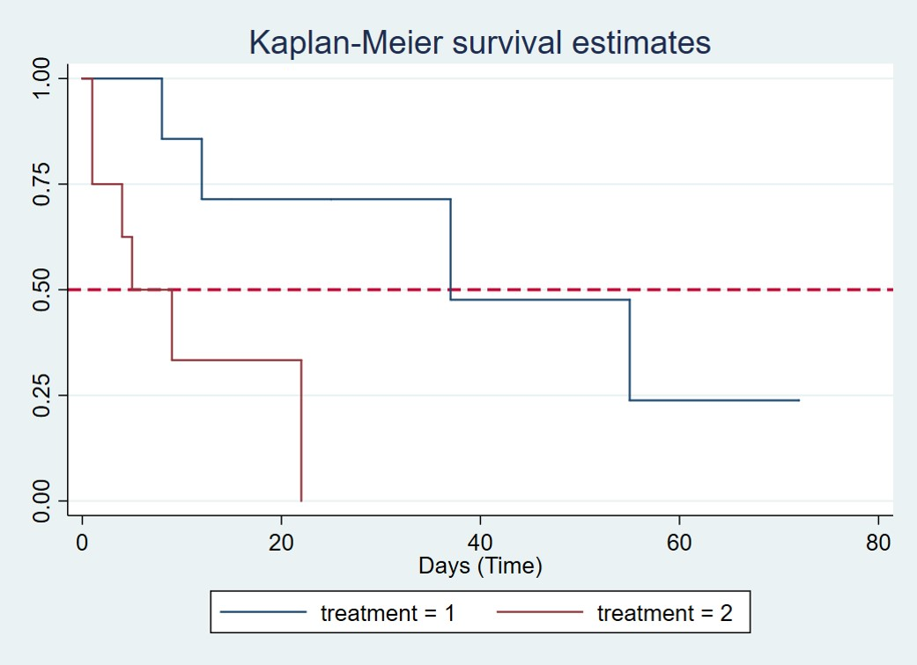
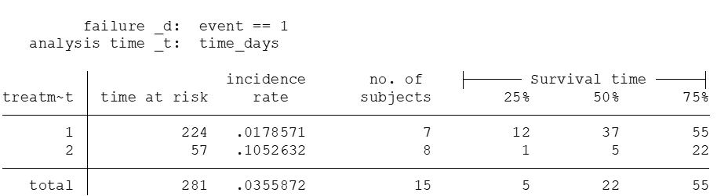
KM survival function curves
Median survival time = 37 days for treatment group 1
Median survival time = 5 days
Notes:
Let’s look at the cumulative survival probabilities or KM survival estimates by treatment groups over the study period.
As you can see, median survival times between two groups seems to be quite different. Patients in treatment 1 group (in blue line) appear to have a higher survival rate than those in treatment 2 group (in red line).
The graph can be also used to estimate the median survival time and the red dotted line represents the probability of survival of 0.5.
The median survival time for those on treatment 2 is 5 days versus about 37 days on treatment 1 as shown in data summary table. Please check 50% survival time for each group in blue box.
Please see Slide 32 for basic STATA commands that were used to generate the results shown in this Module.

Slide 9
Part 2 - Log rank test
Notes:
Let’s see whether survival probabilities between two treatment groups are statistically significantly different using the Log Rank test.

Slide 10

Log-rank Test
Mantel-Cox test (aka)
Popular non-parametric test to compare the survival curves (event free) between groups
S(t) for each group, dependent of time, t
It does not require us to know anything about the shape of the survival curve or the distribution of survival times.
Works with censored data
Works with varying periods of follow-up
Allows you to test the relationship between survival (outcome) and a SINGLE “exposure” variable
Stratification to adjust for a confounding (categorical) variable
Notes:
The log rank test also known as Mantel-Cox test is a popular non-parametric test to test the null hypothesis of “no difference in survivals” between two or more independent groups.
The test compares the overall survival curves between groups. By comparing estimated survival curves in each groups in previous slide, we can test whether the survival curves are identical between treatment 1 and treatment 2 groups or not.
Please note that there are several variations of the log rank test statistic that are implemented in different statistical programs.
The log rank test can be used in dataset with censored data or varying degrees of follow-up. One benefit of using this method is that we do not need know about the shape of the survival curves at all.
On the other hand, it is less useful to examine the difference in survival functions between groups are influenced by covariates or confounding factors.

Slide 11
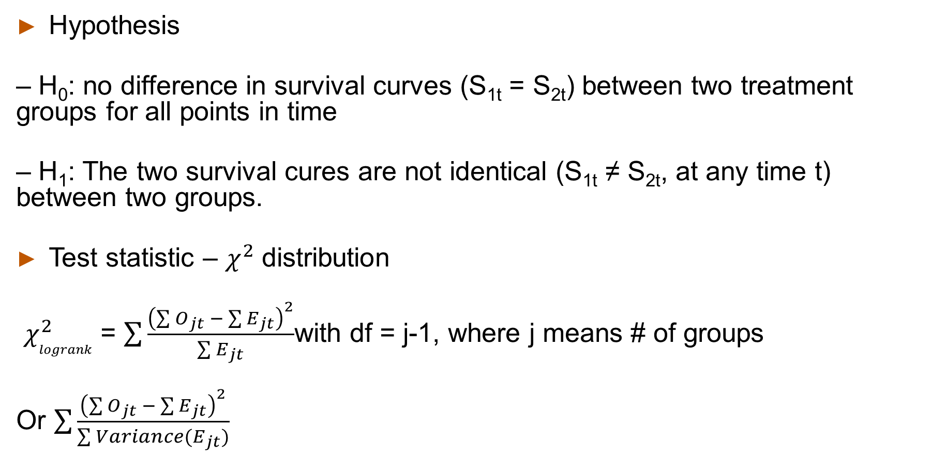
Test of hypothesis
Hypothesis
– H₀: no difference in survival curves (S_{1t} = S_{2t}) between two treatment groups for all points in time
– H₁: The two survival cures are not identical (S_{1t} ≠ S_{2t}, at any time t) between two groups.
Test statistic – $χ^{2}$ distribution
$χ_{logrank}^{2}$ = $\sum{\frac{{\left(\sum{O_{jt}} − \sum{E_{jt}}\right)}^{2}}{\sum{E_{jt}}}}$with df = j-1, where j means # of groups
Or $\sum{\frac{{\left(\sum{O_{jt}} − \sum{E_{jt}}\right)}^{2}}{\sum{{Variance(E}_{jt})}}}$
Notes:
The log rank test compares the observed number of events in each group to the expected number under the null hypothesis.
Null hypothesis is that there is no difference in survival curves (S_{1t} = S_{2t}) between two treatment groups at significant level.
Alternative hypothesis is that the two survival cures are not identical (S_{1t} ≠ S_{2t}, at any time t) between two treatment groups. Please pay attention to time (t) component here.
The log rank statistic is approximately distributed as a chi-square statistic. “O” mean the sum of the observed number in the treatment 1 and treatment 2 over time and E means the expected number.
Please note again that there are several variations of the log rank statistic. Some statistical computing packages include variance of expected events in the equation for the log rank test to compare two independent groups

Slide 12
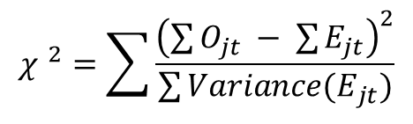
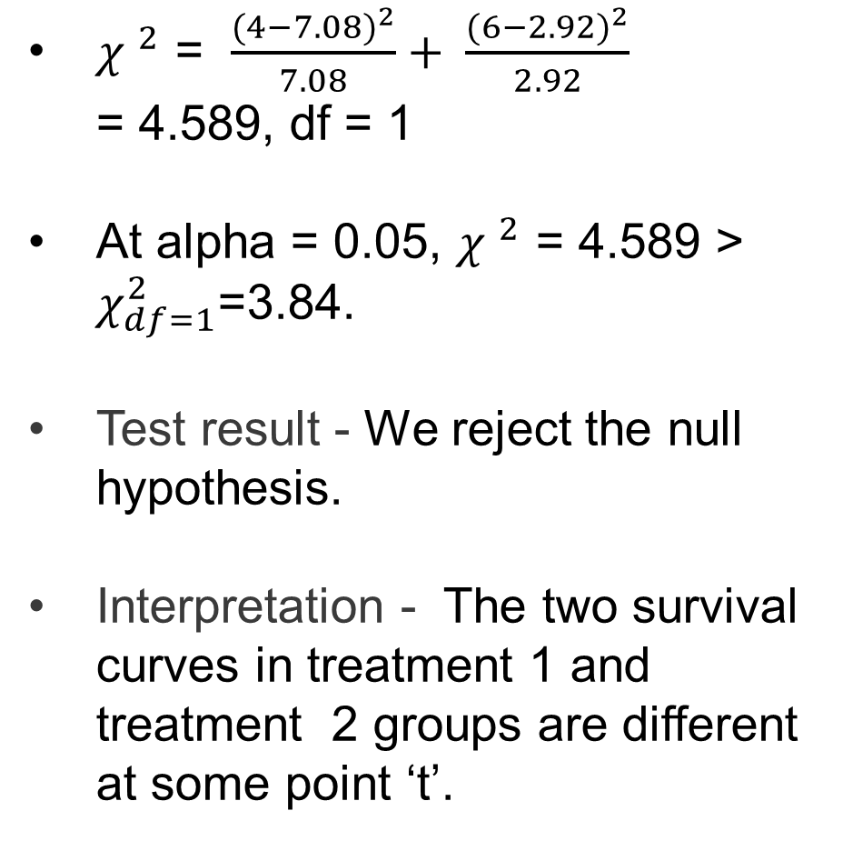
Log rank test
${χ }^{2}$ = $\frac{{(4−7.08)}^{2}}{7.08}+ \frac{{(6−2.92)}^{2}}{2.92}$
= 4.589, df = 1
At alpha = 0.05, ${χ }^{2}$ = 4.589 >
$χ_{df=1}^{2}$=3.84.
Test result - We reject the null hypothesis.
Interpretation - The two survival curves in treatment 1 and treatment 2 groups are different at some point ‘t’.
$${χ }^{2}=\sum{\frac{{\left(\sum{O_{jt}} − \sum{E_{jt}}\right)}^{2}}{\sum{{Variance(E}_{jt})}}}$$
Notes:
Let’s look at the log rank test results obtained from STATA. The calculated chi-square test statistic is about 4.588 based on table and previous equation.
Please ignore the reported chi-square static (5.68) from STATA for a minute.
We can compare this chi-square test statistic and a critical value with df=1 at significance level of 0.05, which is a value of 3.84.
So we reject the null hypothesis at significance level of 0.05. We conclude that there is significant difference in two survival curves from treatment 1 and treatment 2 groups at some point of time during the study period in our example.
In other words, the treatment is associated with time to death in study patients.
As discussed before, STATA or other statistical programs use slight different formula to calculate the chi-square test statistic.
When you use STATA for your analysis, please use the reported chi-square test statistic.

Slide 13

Part 3 – Hazard and Cox proportional hazards regression analysis

Slide 14
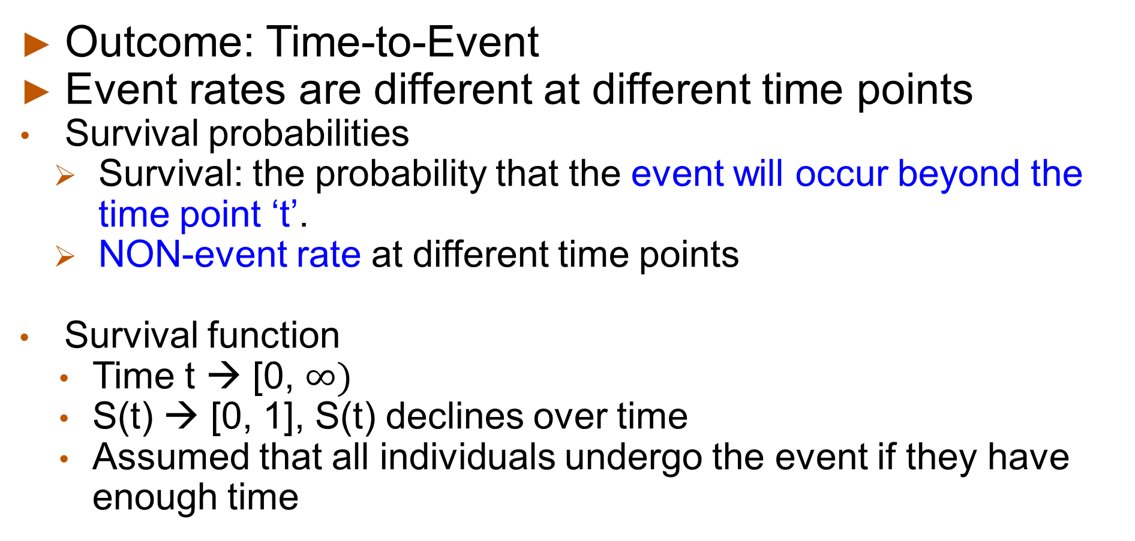
Survival probability
Outcome: Time-to-Event
Event rates are different at different time points
Survival probabilities
Survival: the probability that the event will occur beyond the time point ‘t’.
NON-event rate at different time points
Survival function
Time t → [0, $∞)$
S(t) → [0, 1], S(t) declines over time
Assumed that all individuals undergo the event if they have enough time
Notes:
Let’s review again about the survival probability. You know how to calculate survival probabilities based on Actuarial Table (or Life Table) and Kaplan-Meier (Product limit) approach.
The survival function or curve is estimated from event status and follow up time.
Survival probabilities ranges between 0 and 1 and it declines over time.
Time information can be years, months or days.

Slide 15
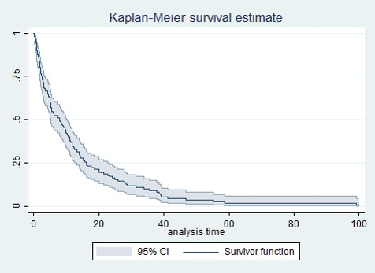
Survival function: S(t)
A plot of survival probabilities over time at time t = S(t) → Probability of surviving at least to time t
Median survival time ~ 9 months
Months
Notes:
After we estimate the survival probability (or cumulative probability of survival), we can plot the survival curve.
Survival curves are plotted as step functions based on survival probability, as shown in the figure above.
Time is shown on the X-axis and survival (based on Kaplan-Meier approach) is shown on the Y-axis. Please note that the percentage of participants surviving does not always represent the percentage who are alive when the event of interest is death. Or the percentage of surviving (not having event of interest) does not represent the % of people who were event free. "Survival" can also refer to the proportion who are free of another outcome event (e.g., percentage free of MI or cardiovascular disease), or it can also represent the percentage who do not experience a healthy outcome.
The median survival is about 9 months (i.e., 50% of the population survive 9 months according to the plot in this slide.

Slide 16


Hazard rate
An instantaneous incidence rate (density) is the so-called hazard rate.
Event rates that vary substantially over time are called hazard rates.
The hazard rate is the probability that an individual will experience an event at time t (assuming the event has not happened).
The denominator for the hazard rate is the number of subjects that still have not had the event.
Calculate the event rate for each time period of interest.
Notes:
Let’s switch the gears a little bit to discuss a hazard rate.
An alternative definition of an instantaneous incidence rate (density) is the so-called hazard rate or instantaneous conditional incidence.
The hazard rate can be defined as each individual’s instantaneous probability of the event at precise time t (or at a very small interval [t, t+Δt]), given (or “conditioned” on) the fact that the individual was at risk at time t.
The hazard is analogous to the conditional probability of the event that is calculated at each event time using Kaplan-Meier’s approach; however, because its denominator is “time-at-risk,” it is a rate measured in units of time^{–1}. Please note the denominator is “time” here.

Slide 17
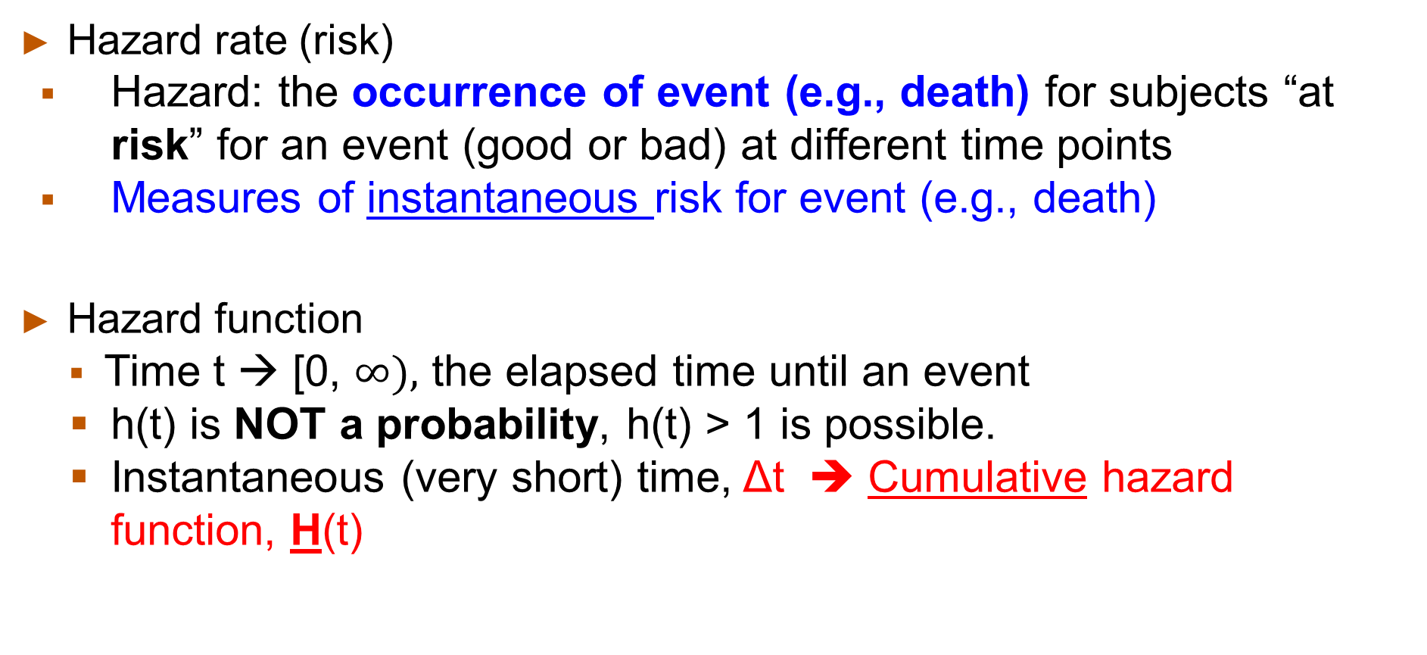
Hazard rate
Hazard rate (risk)
Hazard: the occurrence of event (e.g., death) for subjects “at risk” for an event (good or bad) at different time points
Measures of instantaneous risk for event (e.g., death)
Hazard function
Time t → [0, $∞),$ the elapsed time until an event
h(t) is NOT a probability, h(t) > 1 is possible.
Instantaneous (very short) time, Δt ➔ Cumulative hazard function, H(t)
Notes:
Cox’s proportional hazards model is analogous to a linear or logistic regression model that can include multiple confounders or covariates.
We can examine the difference between in survival or failure times of particular groups of participants while we adjust for other factors related to time to event or treatment in the model.
Hazard function or hazard rate is a measure of effect in Cox proportional hazards regression models. It represent the RISK of failure, in other words, the RISK of suffering the event of interest given that the participant has survived up to a specific time.
The response variable in the model is the hazard rate or function, which is the probability of experiencing the event of interest given that participants have to be event-free up to a given point in time.
Or it can be the risk for death at THAT moment (spontaneous).
Unlike survival probability (range 0 to 1), the hazard represents the expected number of events per one unit of time. Thus, the hazard in a group can be larger than 1.
If the hazard is 0.5 at time t and the time units are years, then on average, 0.5 events are expected per person at risk per year.
Or we used the reciprocal of the hazard: 1/0.5 = 2, which is the expected event-FREE time (2 years) per person at risk.
The hazard measures the instantaneous risk for outcome. Thus it is would be hard to display individual hazard. Instead, we can calculate the cumulative hazard function H(t).

Slide 18
Hazard rate
Hazard rate cannot be directly calculated → Hazard function over time, or cumulative hazard, can be estimated
If the hazard rate is constant over time and it is equal to 0.03, we expect 0.03 events to occur in one time interval.
If a subject had a hazard rate of 0.03 at time t and another subject had a hazard rate of 0.015 at time t, then the second subject's risk of an event is half of the first subject’s at time t.
Notes:
The hazard rate or function cannot be directly calculated, as it is defined for an infinitely small time interval; however, the hazard function over time can be estimated using available parametric survival analysis techniques.
If the hazard rate is constant over time and it is equal to 0.03, for example, we expect 0.03 events to occur in one time interval. Also, if a subject A had a hazard rate of 0.03 at time t and another subject B had a hazard rate of 0.015 at time t, then the second subject (B)'s risk of an event is half of the first subject’s at time t.

Slide 19

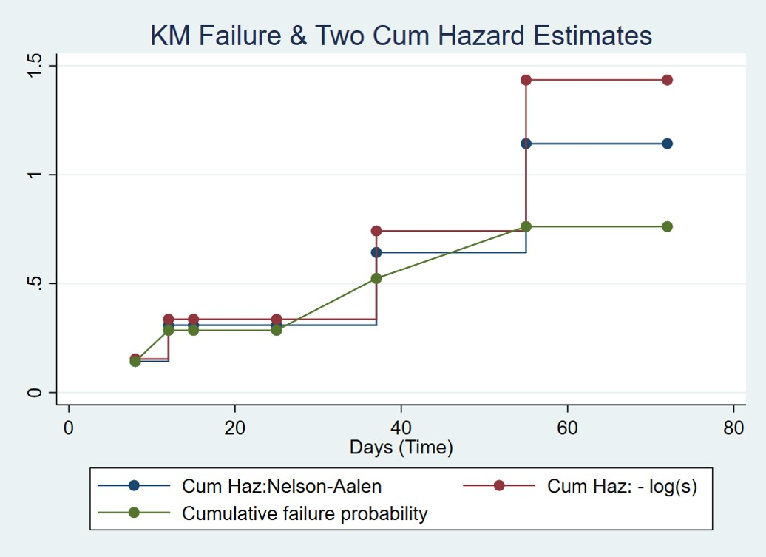
Cumulative hazard functions H(t) – treatment group 1
Treatment group 1
Notes:
There are a number of ways to calculate the cumulative hazard functions. Cumulative hazard functions generally increase over time and as you can tell, the value can be larger than 1.
In this slide, two cumulative hazard functions, H(t) were included.
In Bewick et al paper, the cumulative hazard function is estimated using the cumulative survival function (or survival probability).
As you can see (and Table 4, paper by Bewick et al), cumulative hazard function (Ht) is calculated as minus the log (natural log) of survival function.
The red line on the graph (labelled as Cumulative Hazard: -log(s)) represents these values.
However, in STATA, the most widely used cumulative hazard function is calculated using the Nelson-Aalen method (depicted as Blue line), which uses more complicated formula, rather than – lnS(t).
The Nelson-Aalen method estimates the hazard at each distinct time of death as the ratio of the number of deaths (observed) to the number of expected.
As you see on the graph on the slide, the cumulative hazard values estimated using Nelson-Aalen method tends to be lower than the others (-log(St)).

Slide 20
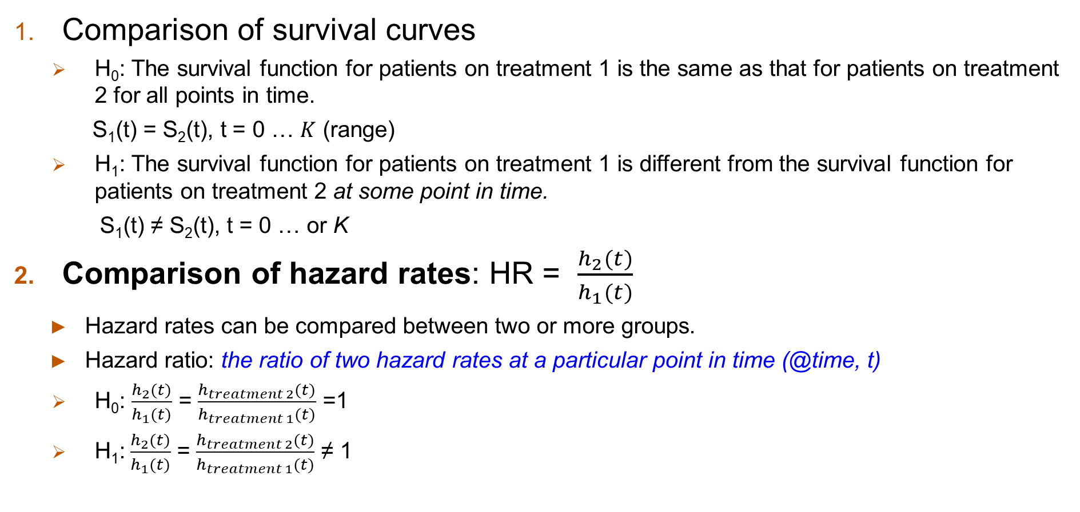
Statistical testing for time-to-event data
Comparison of survival curves
H₀: The survival function for patients on treatment 1 is the same as that for patients on treatment 2 for all points in time.
S₁(t) = S₂(t), t = 0 … $K$ (range)
H₁: The survival function for patients on treatment 1 is different from the survival function for patients on treatment 2 at some point in time.
S₁(t) ≠ S₂(t), t = 0 … or K
Comparison of hazard rates: HR = $\frac{h_{2}(t)}{h_{1}(t)}$
Hazard rates can be compared between two or more groups.
Hazard ratio: the ratio of two hazard rates at a particular point in time (@time, t)
H₀: $\frac{h_{2}(t)}{h_{1}(t)}$ = $\frac{h_{treatment 2}(t)}{h_{treatment 1}(t)}$ =1
H₁:$\frac{h_{2}(t)}{h_{1}(t)}$ = $\frac{h_{treatment 2}(t)}{h_{treatment 1}(t)}$ ≠ 1
Notes:
Again, two functions that are dependent of time are used to test time-to-event data: the survival function and the hazard function as we reviewed already.
The first method is to compare the cumulative survival function. The survival function S(t) is defined as the probability of surviving at least to time t.
The second method is based on the comparison between hazard rates or hazard function.
The hazard function h(t) is the conditional probability of dying (failure or event) at time t having survived to that time.
So, we can compare the survival function (St) between groups or compare the hazard rates via hazard ratio between two treatment groups.
The hazard ratio is the ratio of two hazard rates at a particular point in time and it is analogues to an odds ratio.
Hazard rates can be compared between two or more groups.
The HR in our example is the ratio of the hazard rate at time t for patients in treatment group 2 and the hazard rate at time t for patients in treatment group 1.
The HR can be the ratio of the total number of observed to expected events in two independent comparison groups like in the log rank test.

Slide 21
Hazard Ratio (HR)
Comparing the risk (rate) ratio to 1:
HR that are equal to 1 mean that the hazard rates for the two groups are the same.
HR that are greater than 1 mean that the hazard rate in the numerator is greater than the hazard rate in the denominator.
HR that are smaller than 1 mean that the hazard rate in the numerator is smaller than the hazard rate in the denominator.
Notes:
The interpretation of Hazard Ratio is similar to that of Risk Ratio or Odds ratio.
HR that are equal to 1 mean that the hazard rates for the two groups are the same.
HR that are greater than 1 mean that the hazard rate in the numerator is greater than the hazard rate in the denominator.HR that are smaller than 1 mean that the hazard rate in the numerator is smaller than the hazard rate in the denominator.

Slide 22
Cox proportional hazards regression - Assumptions
“Proportionality assumption”
For any two different subjects, the natural logarithm (log or ln) of hazard functions should be parallel over the study period
Independence of survival times between distinct participants in the sample
A multiplicative relationships between the predictors (Xs) and the hazard
3) Proportional hazards = the RATIO of the hazards (rates) will be same over the study period (the hazards will be proportional over time)
Non-proportional hazards = the ratio of the hazards will VARY over time
Notes:
There are several important assumptions for the appropriate use of the Cox proportional hazards regression model.
These include 1) Independence of survival times between distinct participants in the sample,
2) a multiplicative relationships between the predictors (Xs) and the hazard shown in next slide (see first equation, the product of baseline hazard (h0(t)) and the exponential function of (linear combination) the predictors (Xs)
The third most important assumption is that the ratio of the hazards between groups should be same over the study period. In other words, a constant hazard ratio over time.

Slide 23
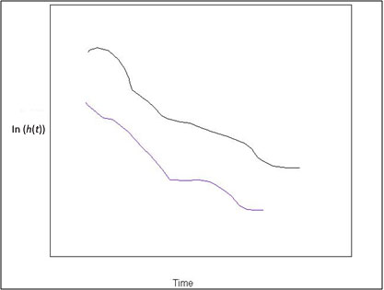
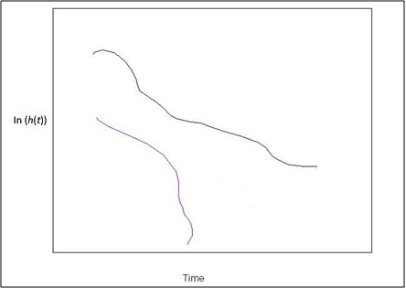

Cox proportional hazards regression - Model
$h\left(t\right)= h_{0}\left(t\right)×exp\left(b_{1}X_{1}+b_{2}X_{2}+…+b_{p}X_{p}\right)$
h(t): the expected hazard at time t
h₀(t): the baseline (unspecified) hazard and represent all of predictors (Xi) are equal to zero (0)
➔ $\ln\left[h\left(t\right)\right]=\ln\left[h_{0}\left(t\right)\right]+b_{1}X_{1}+b_{2}X_{2}+…+b_{p}X_{p}$ ➔ ln[$\frac{h(t)}{h_{o}(t)}]=b_{1}X_{1}$+...
Multiplicative relationship
Proportional hazards
Non-proportional hazards
Notes:
As we discussed before, proportional hazards or Cox regression model is similar to the models such as linear or logistics regression model.
The h(t) is the expected hazard at time t, h₀(t) represent the (unspecified) hazard and represent all of predictors (Xi) are equal to zero (0). Other part of the equation is similar to regression model expression.
Here ‘ln’ represents the natural log.
The assumption that the proportional hazards stay constant over time can be examined on a plot showing the natural logarithm of the estimated cumulative hazard function over time by two groups, for example
Log H(t)s from two groups seem to be parallel over time on the left figure. Or the difference between the logarithms of the cumulative hazard functions is constant unlike in figure on the right.

Slide 24
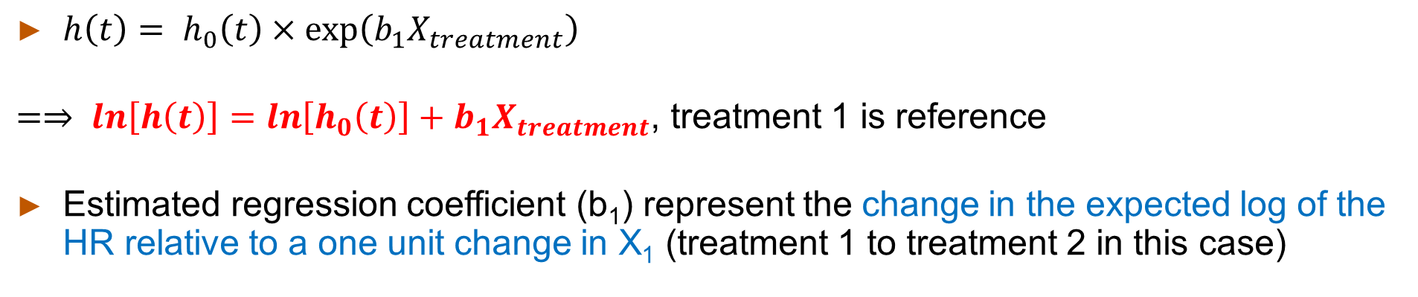
Cox regression analysis (unadjusted) - beta
$h\left(t\right)= h_{0}\left(t\right)×exp\left(b_{1}X_{treatment}\right)$
$=⇒ \ln\left[h\left(t\right)\right]=\ln\left[h_{0}\left(t\right)\right]+b_{1}X_{treatment}$, treatment 1 is reference
Estimated regression coefficient (b₁) represent the change in the expected log of the HR relative to a one unit change in X₁ (treatment 1 to treatment 2 in this case)
Notes:
Let’s examine the dataset using the cox regression analysis.
This output includes only treatment as a predictor for expected hazard function as shown in Cox regression model.
Estimated regression coefficient (b₁=1.818) represent the change in the expected log of the hazard ratio relative to a one unit change in X₁
In this example beta 1 is 1.818 and it represent the change in the expected log of the HR for a patient given treatment 2 compared with a patient given treatment 1.

Slide 25
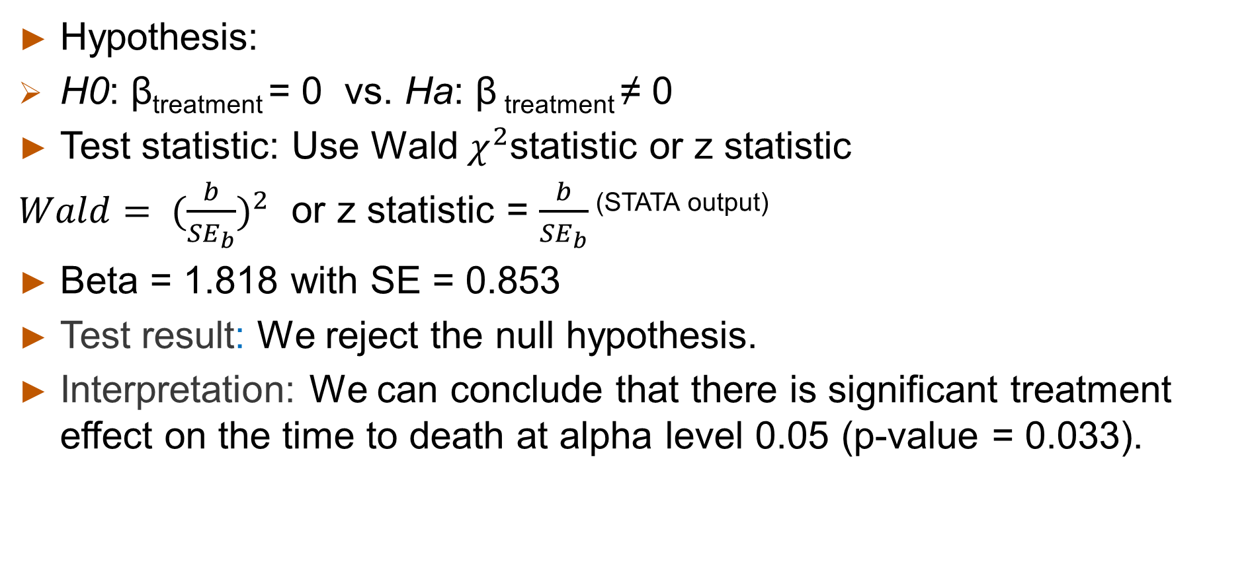
Test of hypothesis for a specific slope
Hypothesis:
H0: β_{treatment} = 0 vs. Ha: β _{treatment} ≠ 0
Test statistic: Use Wald $χ^{2}$statistic or z statistic
$Wald= ({\frac{b}{{SE}_{b}})}^{2}$ or z statistic = $\frac{b}{{SE}_{b}}$ ^{(STATA output)}
Beta = 1.818 with SE = 0.853
Test result: We reject the null hypothesis.
Interpretation: We can conclude that there is significant treatment effect on the time to death at alpha level 0.05 (p-value = 0.033).
Notes:
To test whether the regression coefficient (b) is significantly different from “0”, we can use z-statistic (standard normal) or chi-square statistic.
Where the null hypothesis is true, the treatment is not related to the time to event (death) in patients.
On the STATA output, the beta coefficient for treatment effect is 1.818 and it is tested under standard normal distribution (z = 2.13, p=0.033) , $χ^{2}$ =~4.537 >$χ^{2}$df=1 = 3.84).
Wald’s chi-square ($χ^{2}$) statistic is about 4.547 with df=1, and it is larger than a critical value 3.84 at alpha level of 0.05.
Thus we can reject the null hypothesis and we conclude that there is significant treatment effect on the time to death.
This cox regression analysis result has similar conclusion as the log rank test in Slide 12.

Slide 26
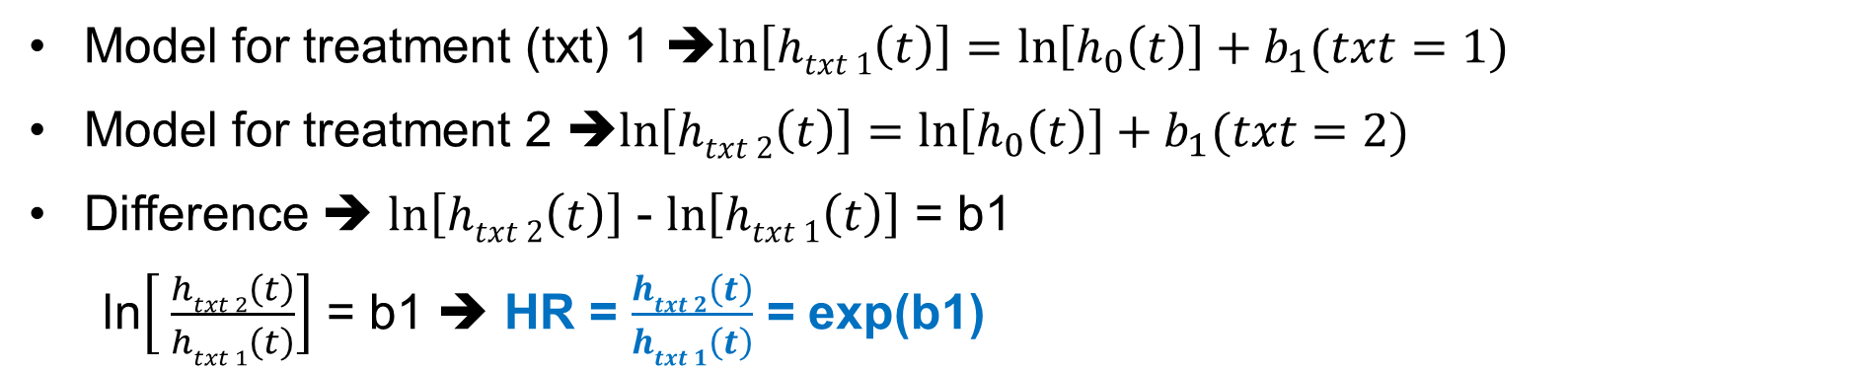
Cox regression analysis (unadjusted) - HR
Model for treatment (txt) 1 ➔$\ln\left[htxt 1\left(t\right)\right]=\ln\left[h_{0}\left(t\right)\right]+b_{1}(txt=1)$
Model for treatment 2 ➔$\ln\left[htxt 2\left(t\right)\right]=\ln\left[h_{0}\left(t\right)\right]+b_{1}(txt=2)$
Difference ➔ $\ln\left[htxt 2\left(t\right)\right]$ - $\ln\left[htxt 1\left(t\right)\right]$ = b1
ln$\left[ \frac{htxt 2\left(t\right)}{htxt 1\left(t\right)}\right]$ = b1 ➔ HR = $\frac{htxt 2\left(t\right)}{htxt 1\left(t\right)}$ = exp(b1)
exp(1.818166)
Notes:
Again, the estimated coefficient in the Cox proportional hazards regression model, b1=1.818, represent the change (or difference) in the expected log of the hazard ratio relative to a one unit change in X1.
If we include other predictors, we will need to hold all other predictors constant.
The antilog of an estimated regression coefficient, exp(bi), produces a hazard ratio. By exponentiating the parameter estimate, exp(1.818166), we will get HR of 6.1605 as shown on this slide ( STATA output in red box)
The antilog of 1.818166, Hazard ratio, is about 6.1605 shown on the output. The 95%CI fall between 1.158 and 32.764.
In terms of interpretation, we can say that the expected hazard is 6.1605 times higher in patients on treatment 2 as compared to the hazard in patients on treatment 1. The 95% CI for the true hazard ratio does not include 1 (the null value).

Slide 27
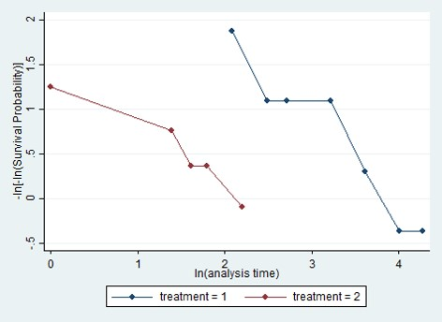
Test for proportional hazard assumption
estat phtest
stphplot, by(treatment)
Based on the proportional-hazards assumption test based on Schoenfield residuals, we do not reject the null (proportional hazards, p=0.968).
The graphical display of log-log of survival function also showed that the HR between two groups is relatively constant over time.
Notes:
There are several approaches to assess the proportionality assumption for Cox-regression model.
Some are based on statistical tests and others are based on graphical assessments.
There are several graphical displays that can be used to assess, whether the proportional hazards assumption is reasonable.
Regarding the statistical testing approach, predictor by time interaction effect is included in the model and it is tested for statistical significance.
Based on the proportional-hazards assumption test based on Schoenfield residuals, we do not reject the null (proportional hazards, p=0.968).
Thus the assumption of proportionally was not violated.
The graphical display of log-log of survival function also showed that the HR between two groups is relatively constant over time.

Slide 28
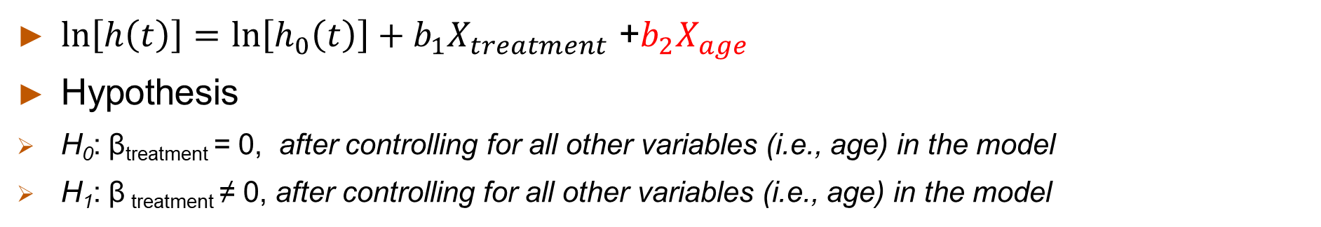
Cox regression analysis (age adjusted) - beta
$\ln\left[h\left(t\right)\right]=\ln\left[h_{0}\left(t\right)\right]+b_{1}X_{treatment}$ +$b_{2}X_{age}$
Hypothesis
H₀: β_{treatment} = 0, after controlling for all other variables (i.e., age) in the model
H₁: β _{treatment} ≠ 0, after controlling for all other variables (i.e., age) in the model
Notes:
Let’s talk about the age adjusted model. In this model, we include treatment as independent variable and age as a confounder (or 2nd explanatory variable).
The null hypothesis for the beta coefficient for treatment is shown on the slide.
Please note the test is conducted while all other variable, in this example age in particular, are held constant.
The relationship between treatment and the time to death in this example was changed a little bit from beta coefficient of 1.818 to 1.887.
The statistical testing result (p value of 0.052) indicated that we may not reject the null hypothesis at significance level of 0.05.
However, there is a significant relationship between age and the time to death in this example. The beta coefficient for age is 0.220 and it seems to be significant (different from 0, p-value = 0.010 after controlling for treatment in the model).
We can interpret that there is a 0.2204 unit increase in the expected log of the relative hazard for each one year increase in age, holding treatment constant (give the same treatment).
Let’s calculate the HR by exponentiating the beta coefficients.

Slide 29
Cox regression analysis (age adjusted) - HR
Treatment: The exponential (antilog) of ~1.887 is 6.660 indicating that the expected hazard is 6.600 times higher in patients on treatment 2 as compared to the hazard in patients on treatment 1 while age is held constant.
Age: The exponential (antilog) of ~0.220 is 1.246 indicating that the expected hazard is 1.246 times higher in a patient who is one year older than the other, given both are on the same treatment (or “holding treatment constant”).
Notes:
For the treatment, the expected hazard is 6.600 times higher in patients on treatment 2 as compared to the hazard in patients on treatment 1 while age is held constant.
We can also say the expected hazard of dying in treatment 2 group is about 6.600 times the hazard (risk) of dying in treatment 1 group, while adjusting for age in the model.
The 95%CI fall between 0.980 and 44.449 and these include 1.
For age, the expected hazard is 1.246 times higher in a patient who is one year older than the other, given both are on the same treatment (holding treatment constant).
We can also say that there is an 24.6% increase in the expected hazard related to a one year increase in age, holding treatment constant. The 95%CI fall between 1.054 and 1.473 and these do not include 1.

Slide 30
Cox regression analysis Summary
Treatment to the time to event (unadjusted model);
The expected hazard is 6.1605 times higher in patients on treatment 2 as compared to the hazard in patients on treatment 1. The 95%CIs for the true HR do not include 1 (the null value).
The assumption of proportionality was not violated in this model.
Notes:
Let’s summarize what we have reviewed from previous slides
In a model with only treatment as an explanatory variable, we can say that
The expected hazard is 6.1605 times higher in patients on treatment 2 as compared to the hazard in patients on treatment 1. The 95%CIs for the true HR do not include 1 (the null value).
The assumption of proportionally was not violated in this model.

Slide 31
Summary
Treatment and age to the time to event (adjusted model)
The expected hazard of dying in treatment 2 group is about 6.600 times the hazard (risk) of dying in treatment 1 group, while adjusting for age in the model. The 95%CI fall between 0.980 and 44.449 and these include 1.
The expected hazard is 1.246 times higher in a patient who is one year older than the other, given both are on the same treatment. The 95%CI fall between 1.054 and 1.473 and these do not include 1.
The assumption of proportionally was not violated in this model (p-value=0.955).
Notes:
In a model with treatment as an explanatory variable and age as another variable (or confounder), we can say that
The expected hazard of dying in treatment 2 group is about 6.600 times the hazard (risk) of dying in treatment 1 group, while adjusting for age in the model. The 95%CI fall between 0.980 and 44.449 and these include 1.
The expected hazard is 1.246 times higher in a patient who is one year older than the other, given both are on the same treatment. The 95%CI fall between 1.054 and 1.473 and these do not include 1.
The assumption of proportionally was not violated in this model (p-value=0.955). This result is not shown here but you can check the result by estat phtest (STATA command)

Slide 32
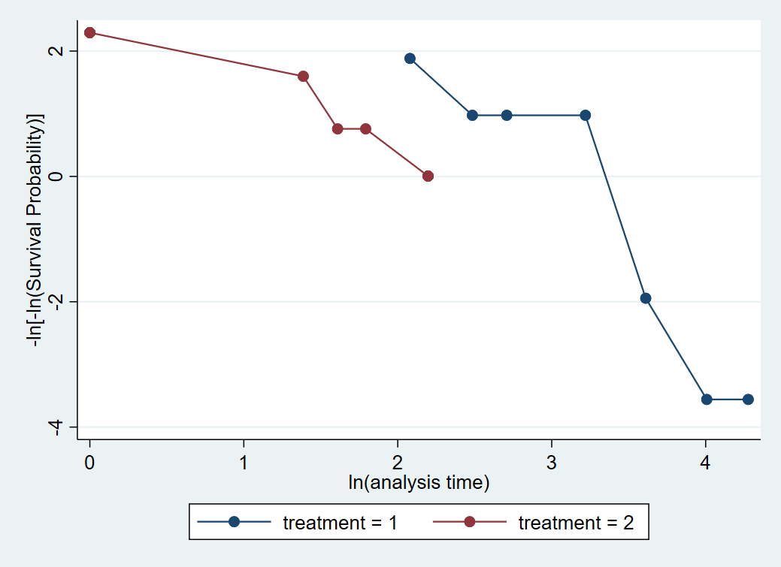
Basic STATA commands (Bewick 2004 data)
To set up a dataset for survival analysis
stset time_days, failure(event==1)
To summarize the data by treatment
stsum, by(treatment)
To conduct a Log Rank test (default)
sts test treatment, logrank
To make life table (KM) and plot survival function curves by treatment groups
sts list, by(treatment)
sts graph, by(treatment)
To conduct a Cox proportional hazards regression
(simple with HR) stcox i.treatment
(simple with beta coefficients) stcox i.treatment, nohr
(add age as covariate) stcox i.treatment age
(check proportional hazards assumption) estat phtest
(plot to proportional hazards assumption) stphplot, by(treatment) or stphplot, by(treatment) adjust (age)
Notes:
This slide contains basic STATA commands used to generate the results shown in this Module.

Slide 33
Helpful YouTube Videos by Stata
Data setup https://www.youtube.com/watch?v=I53Ji4lXoyg
Describe and summarize the data https://www.youtube.com/watch?v=zw8UvYdI8y8
Test the equality of survival function (e.g., Log rank test) https://www.youtube.com/watch?v=W1uympJV7Ko
How to calculate KM survival probability and curves https://www.youtube.com/watch?v=9XZR32zElZ8
Cox proportional hazard model
https://www.youtube.com/watch?v=ime8BaLLXxw
Notes:
Please check out a couple of useful YouTube videos for survival analysis, posted by STATA group.

Slide 34

Acknowledgements
This presentation includes some material/examples/slides from:
Bewick V, Cheek L, and Ball J. Statistics review 12: Survival analysis. Critical Care 2004;8:389-394 PMC1065034
Szklo & Nieto, Epidemiology: Beyond the Basics 4th Edition
Bush HM, Biostatistics: an applied introduction for the public health practitioner. 1st Edition
Notes:
As usual, we will end this lecture with acknowledgments for the sources that helped in making this lecture.

